Slide 1
Multi-target prediction

Slide 2
Outline
What is multi-target prediction?
Intuition and Applications
Basic Use-Cases
Multi-target vs. multi-label classification
Different approaches
Predictive Clustering Trees
Measurement of prediction quality
Hands-on demonstration

Slide 3
What is Multi-target prediction?
Multi-target prediction, multi-output or multi-task learning.
The goal is to predict multiple dependent variables (targets) simultaneously from a set of input variables (features).
Particularly relevant in complex real-world scenarios where multiple outcomes are interrelated and can influence each other.

Slide 4
Intuition
Shared Representation: the targets share some common underlying factors. By learning these shared representations, the model can make more informed predictions for each target.
Exploiting Correlations: Multi-target models aim to exploit the correlations and interactions between targets. E.g., in a health-related dataset.
Joint Learning: Where the model learns to optimize the predictions for multiple targets in a coordinated manner. This joint learning approach can help in uncovering insights that may not be apparent when targets are considered in isolation.

Slide 5
Applications
Complex Interdependencies: Traditional single-target prediction models might ignore interdependencies of targets, potentially leading to suboptimal performance.
Efficiency: Reducing the need to train separate models for each target. This can lead to more efficient use of computational resources and data.
Improved Generalization: Multi-target models can potentially improve prediction accuracy by learning shared representations that capture underlying patterns relevant to multiple targets.

Slide 6
i) Basic Use-Cases: Weather Forecast
Applied to many domains, such as genomics, finance, and recommendation systems, where multiple outcomes or variables are of interest are not independent of each other.
An illustrative use cases of multi-target prediction: in environmental modeling, specifically in predicting various aspects of weather or climate conditions from a set of input variables.
Forecast multiple weather parameters, such as temperature, humidity, precipitation, wind speed, and air pressure, from historical and current weather data.

Slide 7
ii) Basic Use-Cases: Drug Discovery
In drug discovery and personalized medicine, it's crucial to understand how different compounds interact with various genetic markers or cellular processes.
A single drug can have multiple effects, impacting various genes, proteins, or pathways.
Traditional approaches might involve building separate models to predict the effect of compounds on each marker or response, which can be inefficient and may ignore the interdependencies between these effects.

Slide 8
Multi-target vs. multi-label prediction
Multi-target:
Can predict categorical and continous targets as well
Each instance in the dataset has a fix number of targets
Target variables usually have some kind of connection
e.g.: predicting the number of customers and revenue; predicting whether customers take an offer and the number of times they use the service etc.
Multi-label:
Predicts only categorical labels
Each instance in the dataset can belong to multiple categories, but it is not fixed, how many categories they belong to
Target labels usually have some kind of connection
e.g.: predicting what objects are on a picture, predicting movie genres, predicting whether one has different diseases etc.

Slide 9
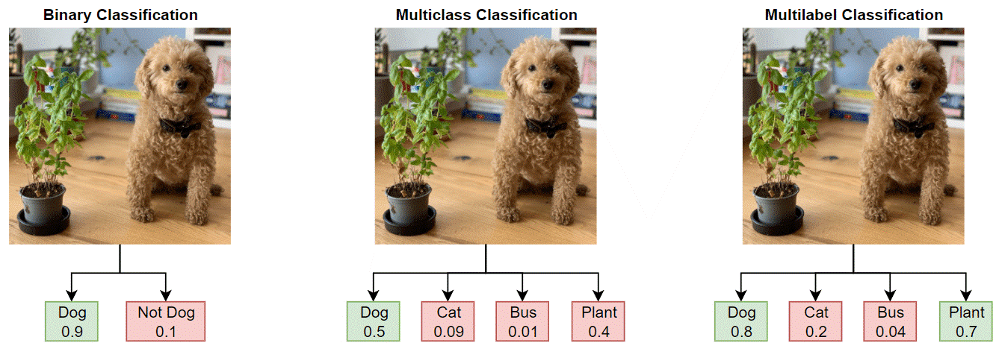
Multi-target vs. multi-label prediction

Slide 10
Different approaches
Problem transformation methods
transform the problem into separate prediction problems
one-vs-all OR one-vs-one
straightforward, but loses information about the relationship of different targets/labels
e.g.: Binary Relevance, Classifier Chains, Conditional Dependency Network, Hierarchy of Multi-label Classifiers (HOMER) etc.
Algorithm adaptation methods
algorithms are changed in order to take account of label/target correlations
can be more complex, but does not lose information about target/label relationships
e.g.: Predictive Clustering Trees, different Neural Networks, Twin Multi-Label Support Vector Machine, Multi-label k Nearest Neighbour etc.

Slide 11
Predictive Clustering Trees (PCT)
Decision tree and random forest modified → TDIDT algorithm
Splitting criterion is changed: Partition data into clusters that are as homogenous as possible in terms of target variables/labels
Similarity measure: depends on the specific task, for MLC: sum of Gini indicies of the labels
Prototype and variance function
Prototype function: representative summary of a given cluster
Variance function: measure of diversity within cluster
Stopping criteria are the usual suspects: max depth, impurity decrease, max features etc.
Efficient computation

Slide 12
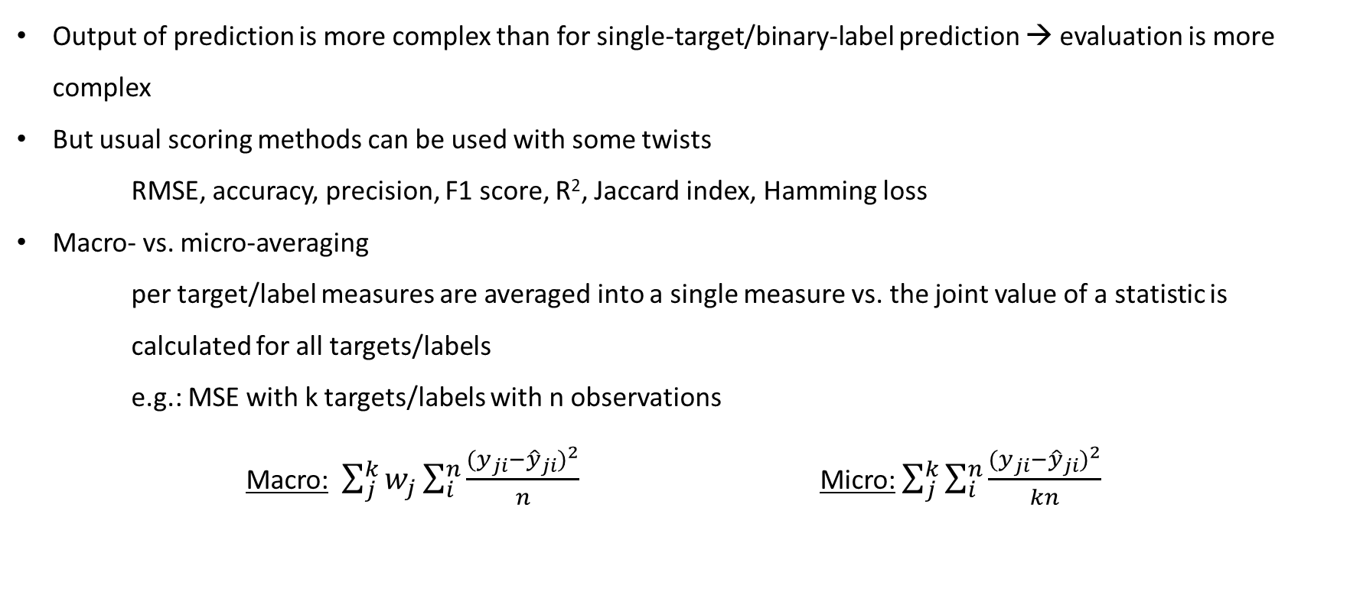
Measurement of prediction quality
Output of prediction is more complex than for single-target/binary-label prediction → evaluation is more complex
But usual scoring methods can be used with some twists
RMSE, accuracy, precision, F1 score, R², Jaccard index, Hamming loss
Macro- vs. micro-averaging
per target/label measures are averaged into a single measure vs. the joint value of a statistic is calculated for all targets/labels
e.g.: MSE with k targets/labels with n observations
Macro: $\sum_{j}^{k}{w_{j}\sum_{i}^{n}{\frac{{(y_{ji}−{\hat{y}}_{ji})}^{2}}{n}}}$ Micro: $\sum_{j}^{k}{\sum_{i}^{n}{\frac{{(y_{ji}−{\hat{y}}_{ji})}^{2}}{kn}}}$

Slide 13
References
Jasmin Bogatinovski, Ljupčo Todorovski, Sašo Džeroski, Dragi Kocev (2022): Comprehensive comparative study of multi-label classification methods, Expert Systems with Applications, Volume 203
Dragi Kocev, Celine Vens, Jan Struyf, Sašo Džeroski (2013): Tree ensembles for predicting structured outputs, Pattern Recognition, Volume 46, Issue 3
https://la.mathworks.com/help/deeplearning/ug/multilabel-image-classification-using-deep-learning.html

